Slide 1
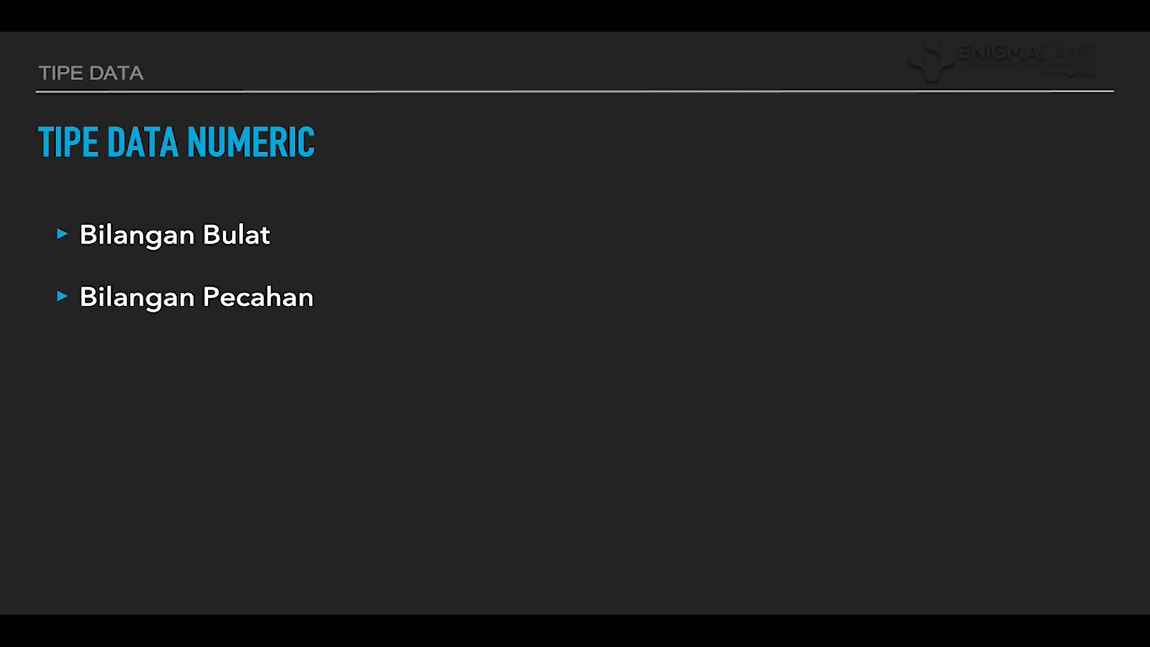

Slide 2
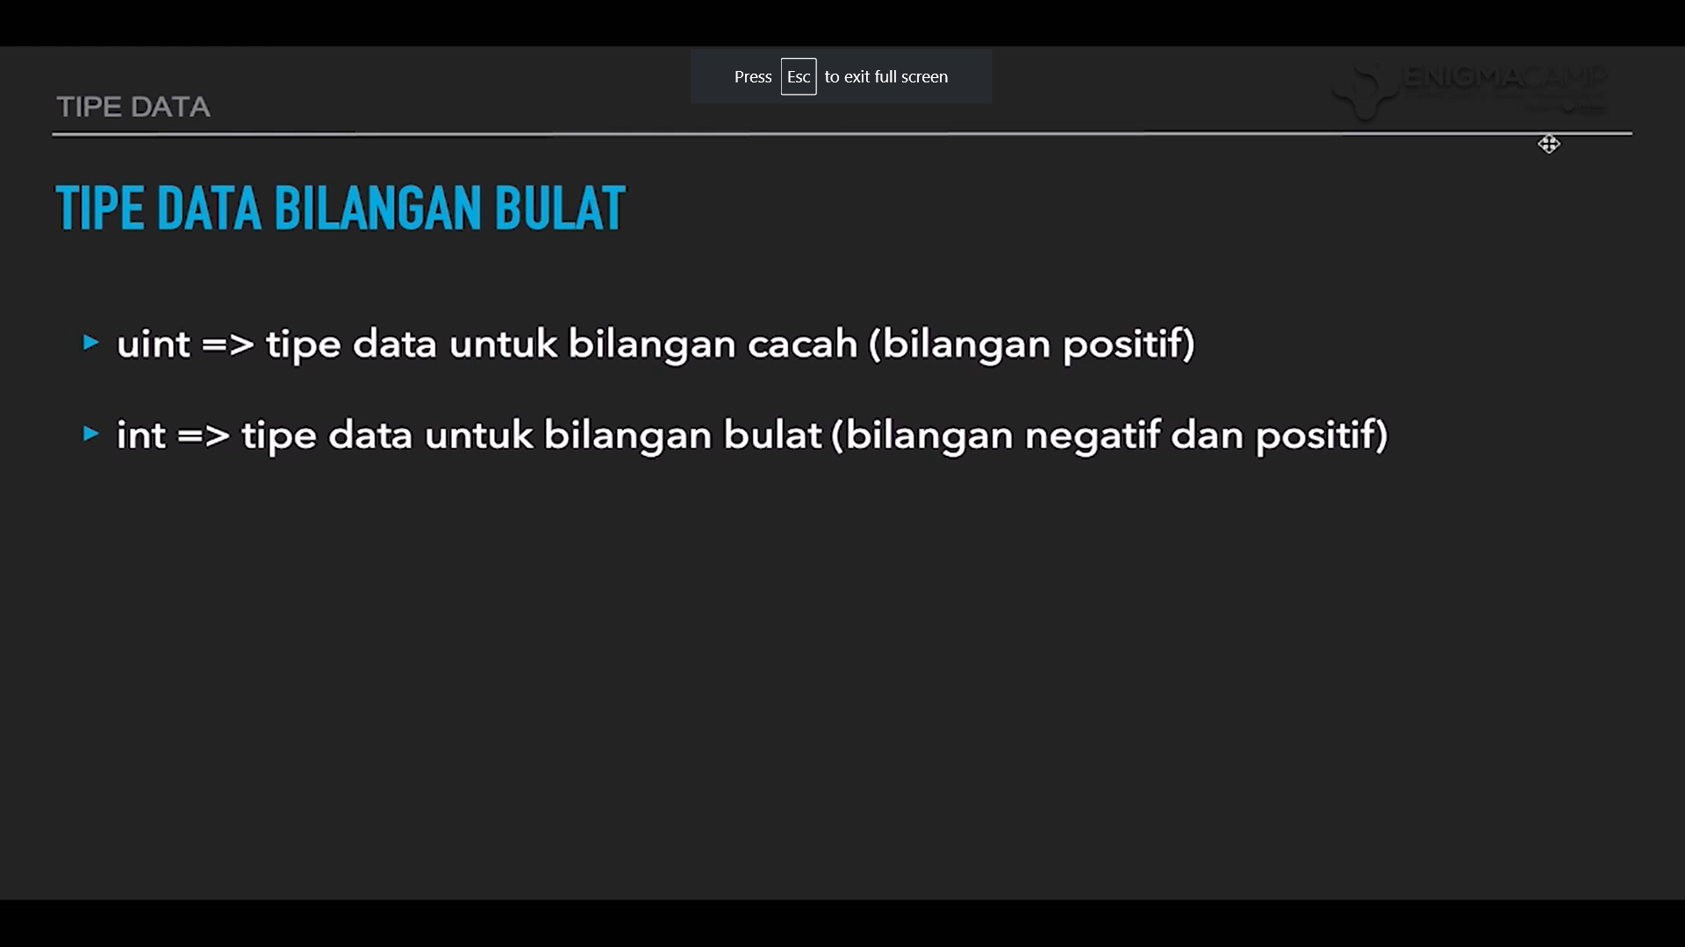

Slide 3
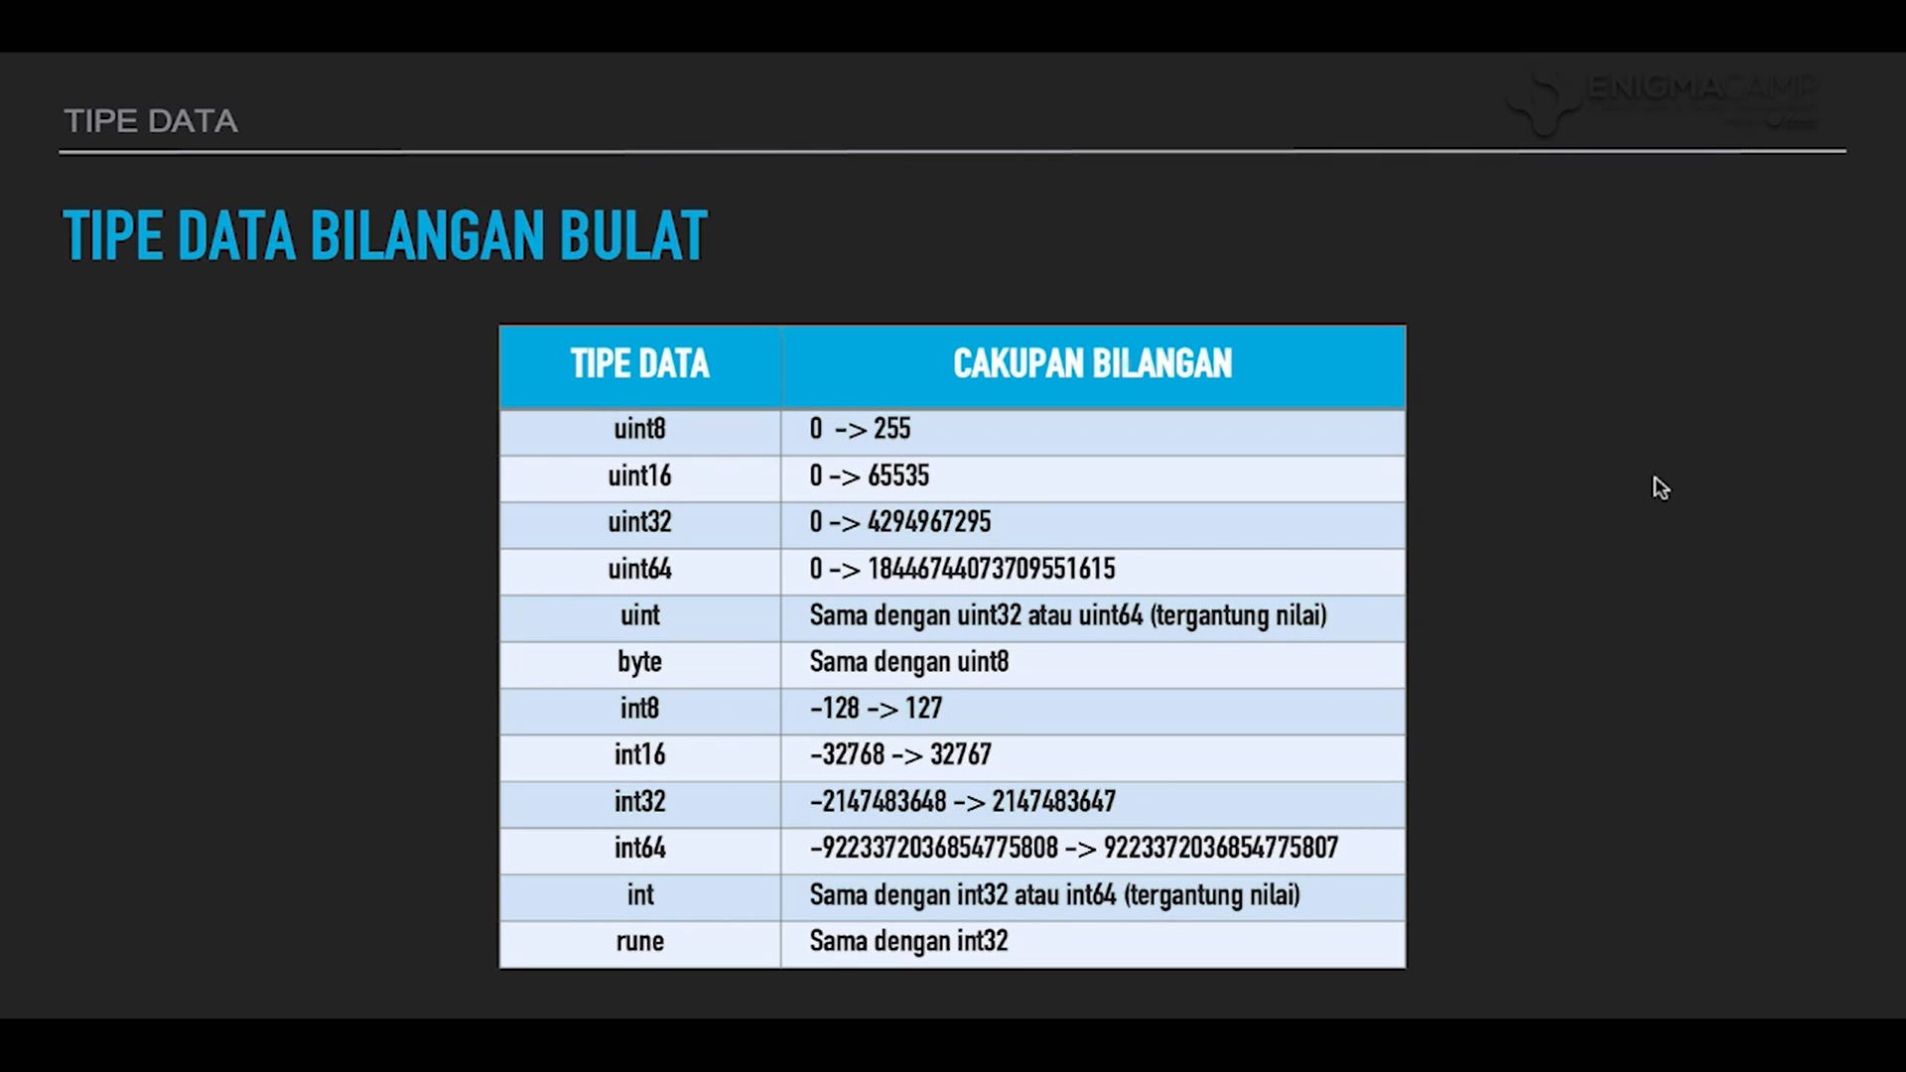

Slide 4
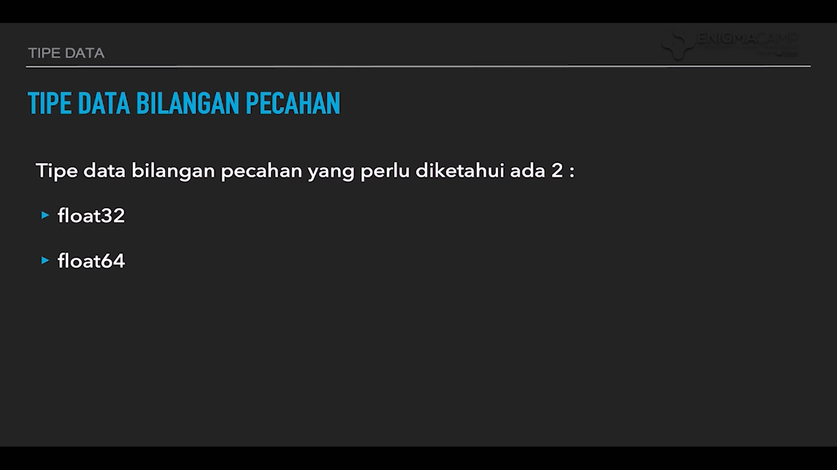

Slide 5
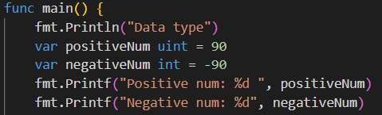
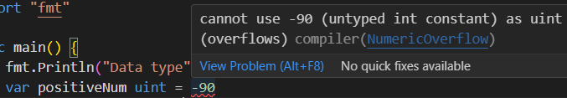
Positive and Negtive number in GoLang
uint variable type will force the value, positive only
In any case if the uint assigned a negative value. it will cause an error.

Slide 6
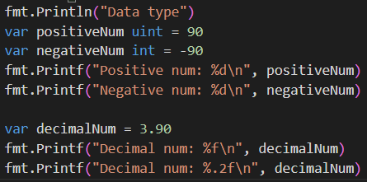
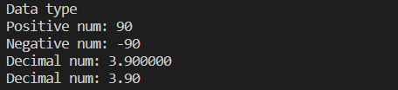
Decimal number
Use %f to output decimal variables not %d at Printf
If you want to print the decimal number like 3.90 you can use %.2f

Slide 7
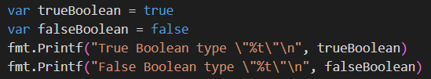
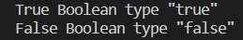
Boolean type
use %t to output boolean variables.
and use \ if you want to write “ double quotes” inside the printf

Slide 8
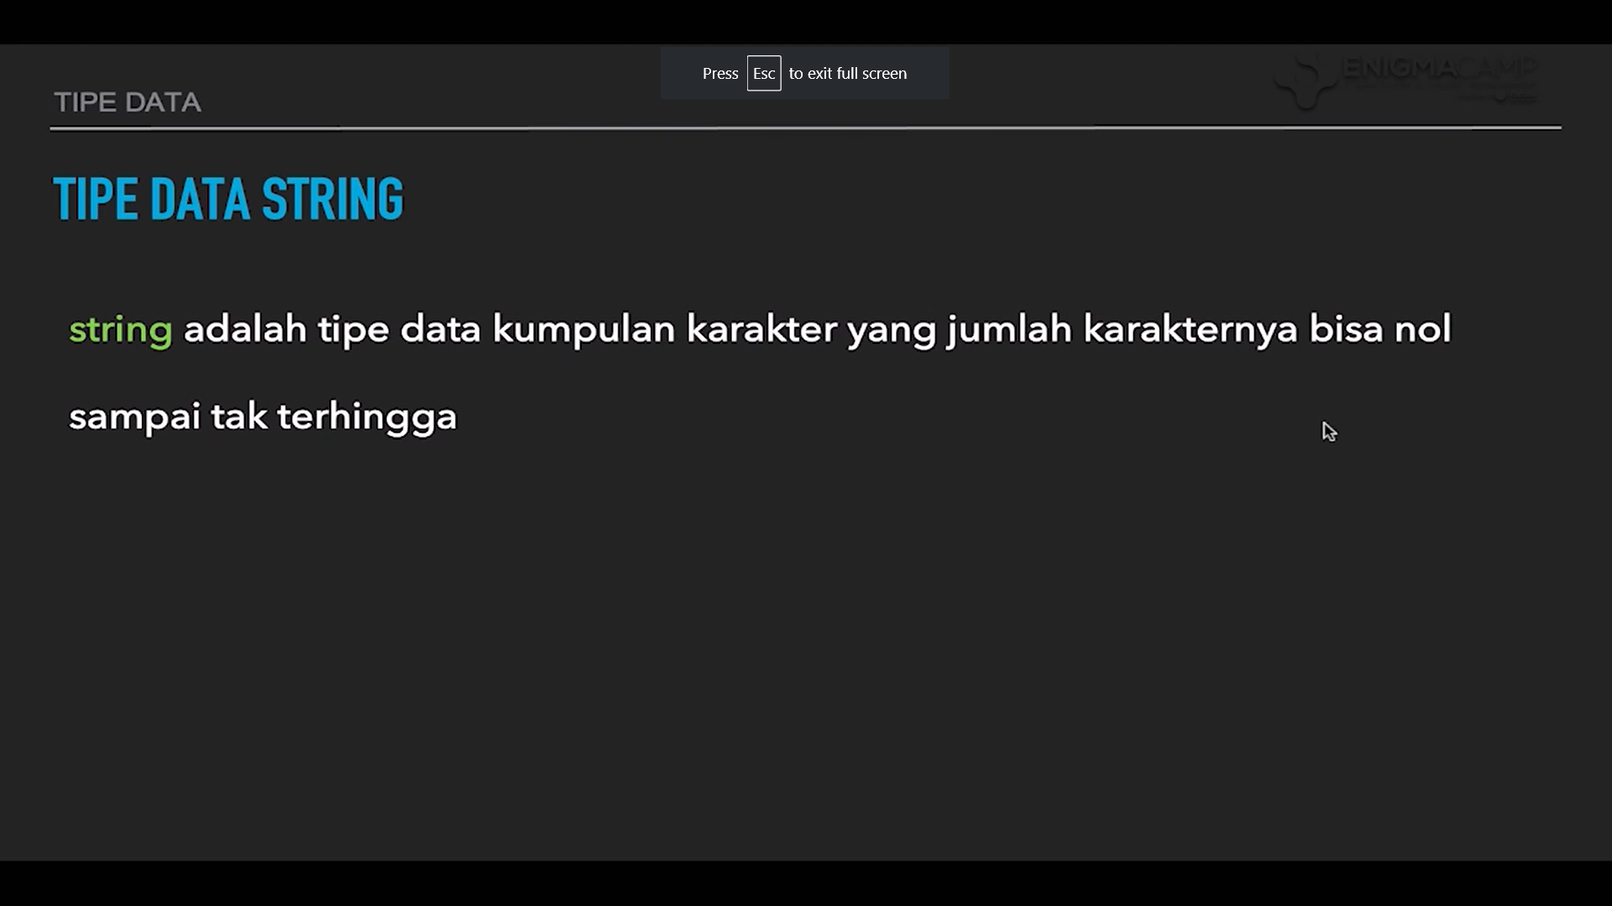

Slide 9
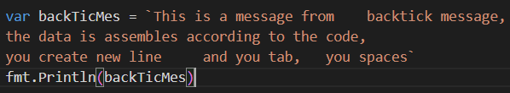

Backtick in string
You can use the backstick ` ` as string variable
but this string will also colide with your new line, tabs, and spaces of the data.

Slide 10
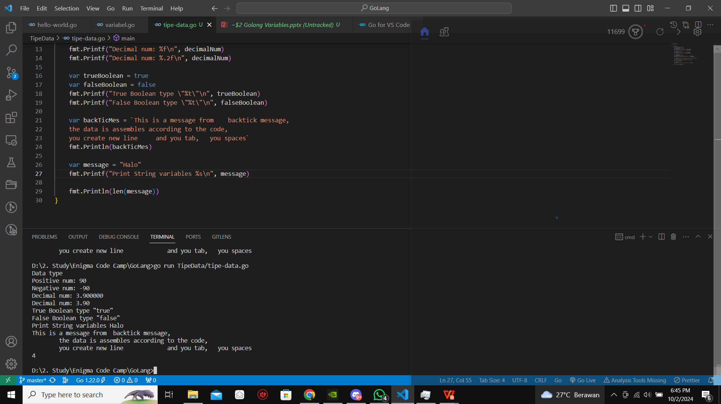
len() - count string length
use len() to count the letter the string variable have

Slide 11
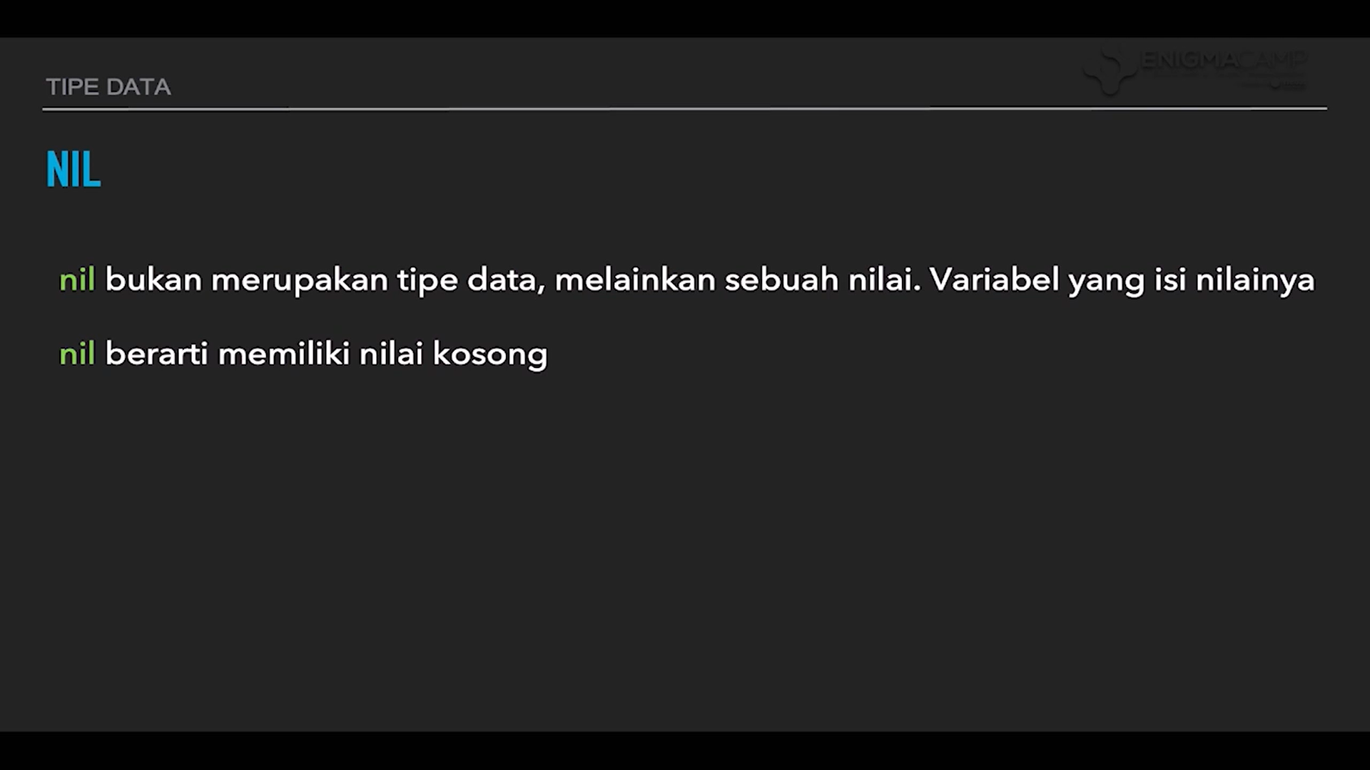

Slide 12
